Slide 1


Abstra
Lazar Milicevic
Weekly support report
Support, Challenges, Sollutions
11.02.2024

Slide 2
Agenda
1. Zendesk ↔ AWS Integration Progress
3. Challenges & Solutions
5. Next Steps
2. Zendesk Ticket Management & Weekly Rotation etc.
4. Hackathon Onboarding & Access Setup
5. Questions & Clarifications

Slide 3
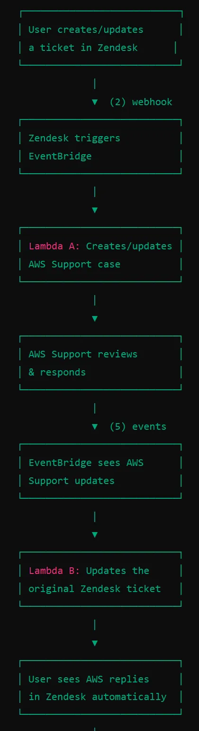
Zendesk ↔ AWS Integration Progress
Customer success: Weekly Support Report – 10.02.2025 – 18.02.2025
What was done:
✅ AWS Support Cases
✅ The integration between Zendesk and AWS Support is now fully operational in production!.
Over 1000+ lines of code written.
Conducted 120+ test tickets in Zendesk and 400+ Zendesk updates.
Successfully tested 120+ AWS console test cases before moving from sandbox to production.
Key achievements:
Two-way sync between Zendesk & AWS.
AWS engineers can now respond directly within Zendesk.
Improved tracking of AWS support cases within Zendesk.
Full documentation is available:
Technical Guide - AWS Zendesk Support Integration

Slide 4
Zendesk Ticket Management & Weekly Rotation etc.
Customer success: Weekly Support Report – 10.02.2025 – 18.02.2025
📌 Zendesk Ticket Management & Weekly Rotation
✅ Efficient Ticket Processing & Cleanup
Processed and routed numerous Zendesk tickets, ensuring timely responses.
Enhanced Zendesk visibility by updating views:
New "SageMaker Blocking Issues - AWS Tickets" View for better tracking.
Completed weekly Zendesk rotation every monday, notifying agents and clearing backlog.
Queue fully cleaned, ensuring a smooth and efficient support workflow.
📌 New "Data Product Requests" Form
Enhanced Internal Request Management
Developed a powerful new Zendesk form with 28 fields and dynamic logic.
Designed to streamline internal processes and improve data requests.
Form structured based on official documentation:
📄 [Proposal-Process-Workflow-to-Contact-Data-Group]
✅ Created a structured onboarding guide for hackathon winners.
✅ Processed and routed numerous tickets over the past two weeks.
✅ Developed a new Zendesk form with 28 fields and dynamic logic.

Slide 5
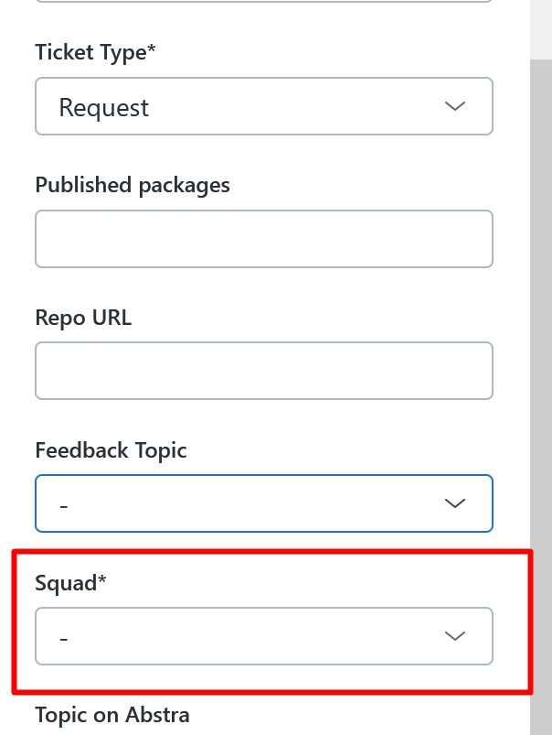
Challenges & Solutions
Customer success: Weekly Support Report – 10.02.2025 – 18.02.2025
Some of them:
🔍 Issue: Assigning Tickets to the L2 Team
Assigning a ticket to L2 without setting the Squad field made it invisible to on-call agents.
✅ Solution:
Now ensuring the Squad field is always set when assigning tickets to L2.
🔍 Issue: Incorrect EventBridge Rule Matching AWS Payloads
EventBridge rules did not properly filter AWS notifications, causing unnecessary Lambda executions on irrelevant events.
✅ Solution:
Adjusted event pattern filters to ensure only relevant AWS events (such as case status changes) are passed to Zendesk.

Slide 6
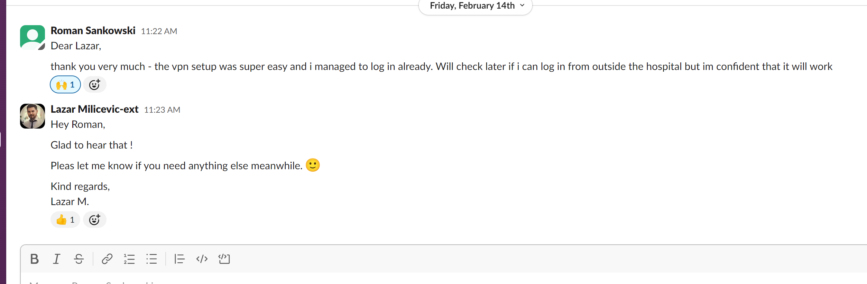
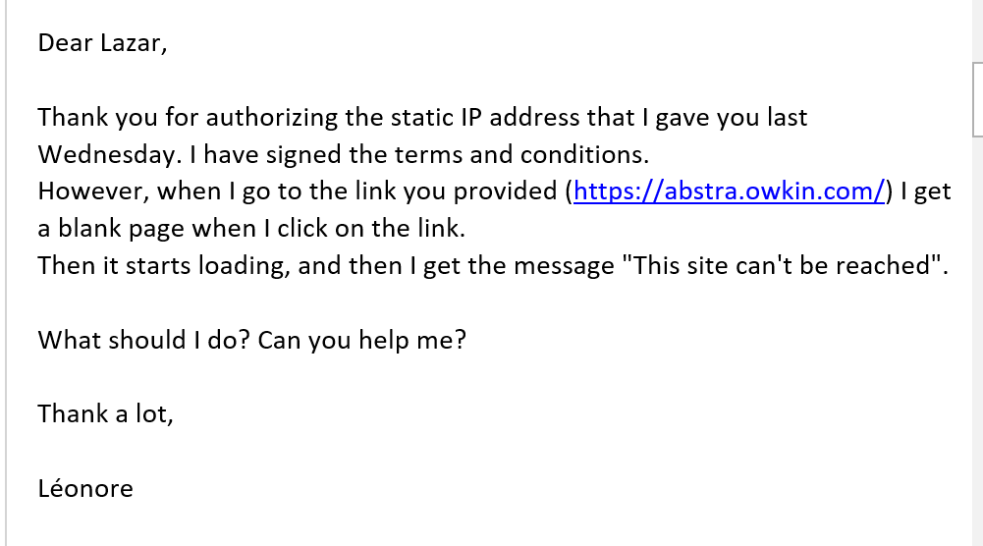
Hackathon Onboarding & Access Setup
Customer success: Weekly Support Report – 10.02.2025 – 18.02.2025
Some of tasks completed:
Tasks Completed:
Account & Access Management:
✅ Created 22 accounts in Keycloak.
✅ Set up 22 customer accounts in Zendesk.
✅ Created projects in Abstra and assigned appropriate permissions to each user.
✅ Sent detailed onboarding instructions to all users for first-time access to Abstra.
✅ Communicated via email and Slack to ensure all users successfully accessed the system.
✅ Hosted multiple meetings to assist users with WireGuard setup and ensure proper access to Abstra.
Survey Distribution:
✅ After ensuring all users had proper access, sent out the onboarding survey to collect feedback.
Next Steps:
🔹 Monitor survey responses and gather insights for improvement.
🔹 Provide additional support if any users face access issues.
🔹 Summarize findings from the survey for further enhancements.

Slide 7

Next Steps
Customer success: Weekly Support Report – 10.02.2025 – 18.02.2025
What will be done:
🔹 Work on SurveySparrow testing and presentation – In progress
🔹 Ongoing monitoring of Zendesk AWS integration – In progress
🔹 Preparation of a presentation for the Canny tool – In progress
🔹 Continuous improvement of ticket management in Zendesk – In progress
🔹 Responding to tickets within the first 10-15 minutes – In progress
🔹 Active involvement in handling L2 tickets – In progress
🔹 Owkin K – Contributing to the project launch with maximum effort

Slide 8

Questions & Clarifications
Customer success: Weekly Support Report – 10.02.2025 – 18.02.2025
?
What else needs to be done regarding the Zendesk AWS integration? Is the transition from using a single AWS account to multiple AWS accounts still relevant?

Slide 9
Thank you!

